Slide 1
Team
222

Slide 2
Index
Introduction
Solar Policy
Battery Energy Storage System
Energy Market Policies in India
EVCI Policies
Return of Invest for EVCI and RES based DER

Slide 3
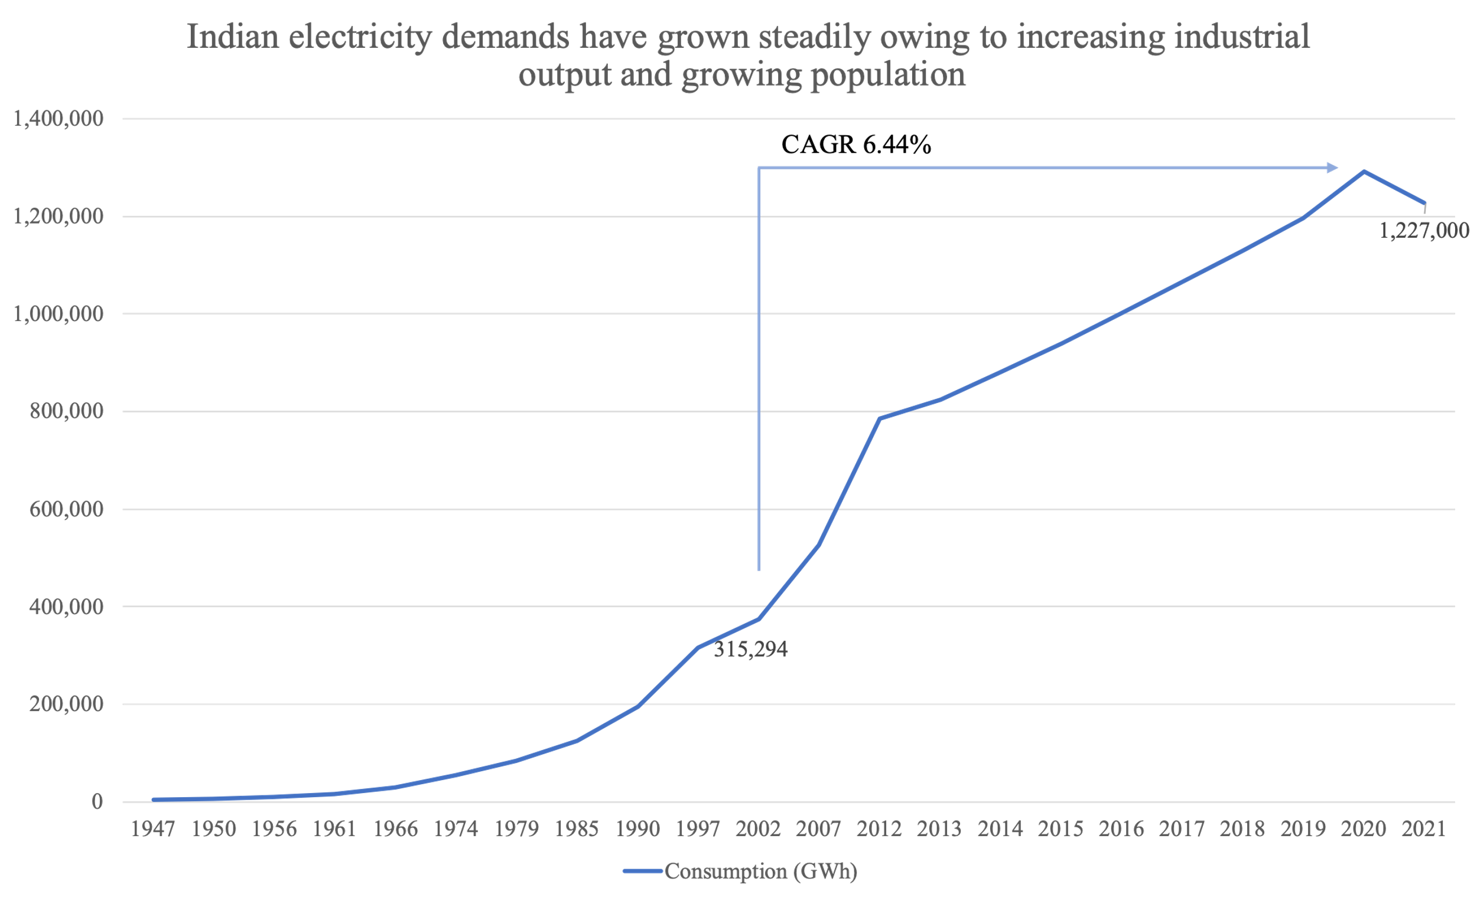
Indian Energy Sector
Indian energy market overview
Installed capacity of national grid- 395 GW.
Solar and wind energy- the main drivers in the transition to renewable energy sources with generation potentials of 46% and 43%, respectively
Growth rates overview
CAGR of 6.44% between 2002-2021 for electricity consumption.
Installed non-fossil fuel based electricity capacity surpassed 40%.

Slide 4
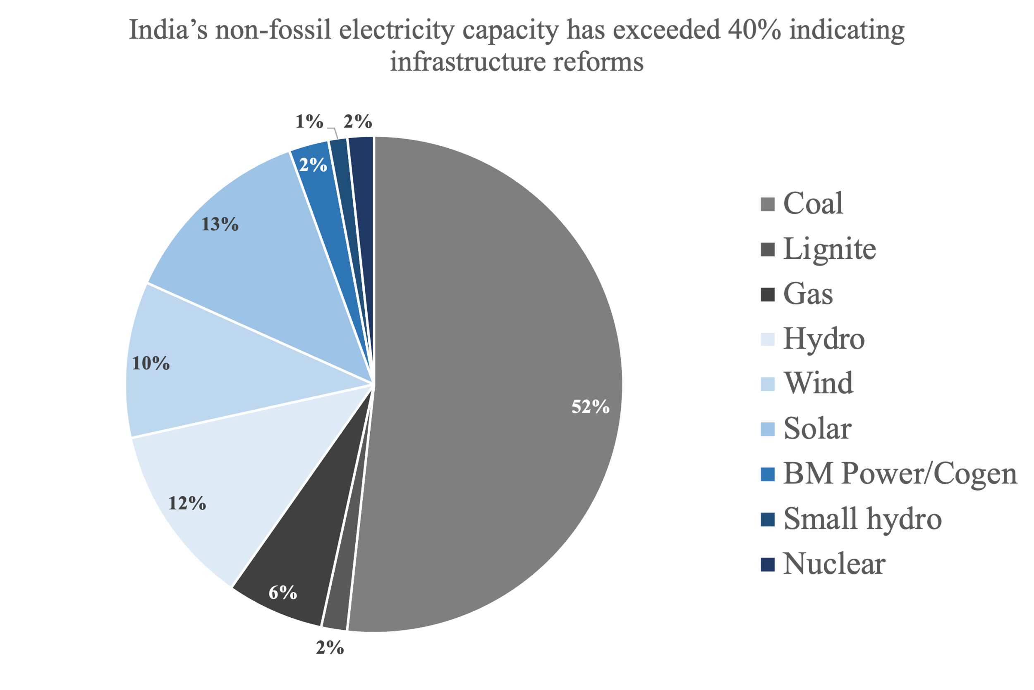
Renewable Power in India
The Indian government has committed 500 GW of renewable energy (RE) power capacity by 2030
152 GW of RE power capacity has already been installed in the country
The government expects 450 GW will be from solar and wind projects and 70-100 GW from hydro projects
Wind energy (post 2014) and solar energy (post 2017) have seen major boosts while simultaneously,.

Slide 5
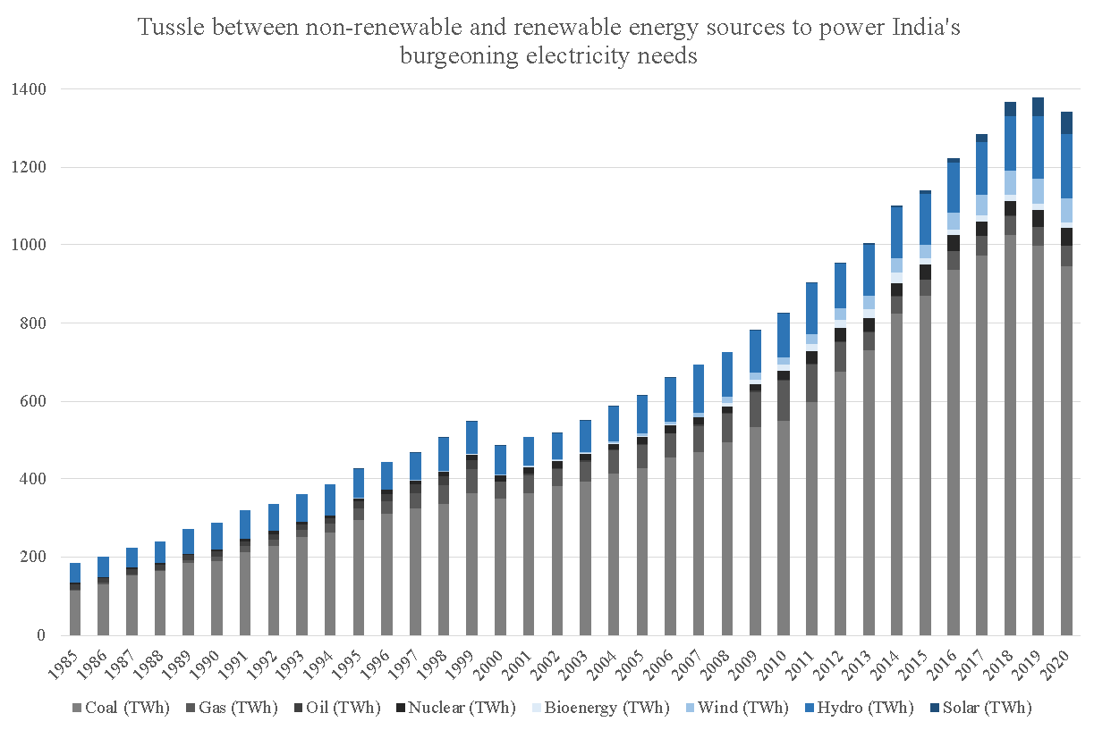
Renewable Electricity Market
Changing market trends
Demands brought down- the peak power deficit from 16.6% in financial year FY 2008 down to 0.4% in FY 2021
Transition to renewable energy - fuelled by favorable policy measures and investment from the private sector.
Electricity costs
Cost of electricity decreases by 46% for India on average if we completely switch to renewable energy sources
Decline in costs due to higher efficiencies and less manufacturing costs and material costs

Slide 6
Overview of Solar Policies
Short term | Mid term | Long term
Utility scale companies boosting up the adoption percentage of the solar integration by setting them up at transmission level | Utility scale companies would set up solar panels at distribution levels | Complete residential ownership at the distribution level
Making the power grid suitable for DER owners
R&D into solar mainly by private players boosting efficiency, affordability, adoption and manufacturing capabilities | Profit sharing model Low cost setup + Profit distribution between the two Full cost setup(DERs)

Slide 7
Solar Policies and Strategies
National Solar Mission (NSM) visions India as a global leader in solar energy.
Targets installing 100 GW grid-connected solar power plants by the year 2022.
INDCs target is 40% installed capacity by non-fossil sources which will be made possible by NSM.
Gradual integration from transmission level to distribution level, which will be achieved by implementing policies in three different phases!
Notes:
Q2 overview

Slide 8
Short Term Policies
Providing tax credits and incentives to the utility scale companies to setup and boost the solar integration at the transmission level
01
Feed-in tariff provision and a fixed market as well as fixed price for renewable energy
02
Investment in R&D of solar panels to improve efficiency, durability and cost
03
Exempting government tax and regulations for companies producing power from renewable upto certain power level
04
Notes:
q2

Slide 9
Mid Term Policies
By adopting the flat rate system to reduce installation costs of solar panels
01
Government-funded grants for research in more efficient solar panels, storage solutions and distribution systems
02
Using innovative technologies like floating solar panels and indium tin oxide electrodes with transparent screens
03
Notes:
q2

Slide 10
Long Term Policies
Providing industrial incentives- low interest loans for installation of solar PVs at the
01
Government can now reduce tax incentives and increase electricity prices
02
Boosting indigineous manufacturing of solar PVs and upskilling labour to ultimately become a global supplier of PVs
03
Recover and reuse raw materials from old and worn solar PVs
04
Notes:
Q2

Slide 11
Battery Energy Storage Systems
We aim to facilitate battery storage demand creation for both electric vehicles and stationary storage along with development of a complete domestic supply chain & Foreign Direct Investment in the country.
Types of storage systems:
Generation coupled storage system
Transmission coupled storage system
Behind the meter storage systems
PLI scheme has a budget overlay of 18,100 crore. An investment of 45,000 crores is expected. Also, 2-2.5 lakh rupees will be saved by oil import bill reduction.
Notes:
Q3

Slide 12
Short Term Policies
Reduce import duties on batteries from 40.8% to 30%
01
Grant funds in order to promote R&D on BESS with the aim of making their production economical
02
03
Incentives to motivate setting up of BESS by utility and energy companies
04
Setting up of a BESS regulatory and operatory body
Notes:
3rd question

Slide 13
Mid Term Policies
Set up 15000 BESS with 200 kWh capacity at offices and public places
01
Set up recycling stations to extract metals for production of batteries
02
Special loans to aid in setting up of BESS at institutions and residential places
03
Notes:
3rd questions

Slide 14
Long Term Policies
Financial incentives to promote residential BESS
01
Setting up of and strict adherence to energy storage targets to shift to distributive scale storage systems
02
Decrease import duty on Lithium from 29.8% to 18-20% to boost battery manufacturing, and increasing production
03
Notes:
3rd ques

Slide 15
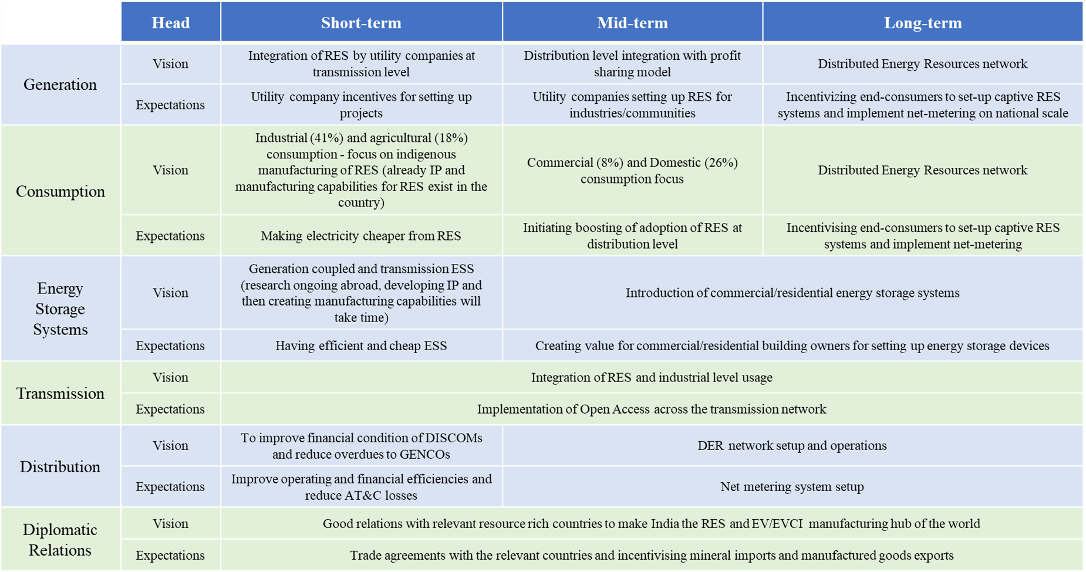
Energy Market Policies - India

Slide 16





Challenges in the Indian Energy Market
01
02
03
04
05
1
2
3
4
5
Problems of land acquisition due to high cost
Exclusion of GST in Electricity sales
Heavy import tariffs on raw materials
Banning of Third Party Sale
Lack of Intellectual Property and manufacturing capabilities for ESS
Notes:
Q5

Slide 17
Short Term Policies
Inclusion of electricity under GST and reassuring of future power costs by signing a PPA
01
Reducing import tariffs on ESS and providing financial support to boost R&D
02
Benefits on RPO qualified projects and OTC exchange of RECs
03
Green bank systems along with green bonds
04
Notes:
q5

Slide 18
Short Term Policies
Decreasing non-tariff and tariff barriers to avail Open Access
05
100% collection efficiency and adopting prepaid meters
06
Good diplomatic relations are necessary to make sure that we have access to the latest technology from around the world
07
Single window approval system to be introduced and Digitizing land records
08
Notes:
q5

Slide 19
Mid Term policies
01
Setting up a marketplace to bring renewable energy asset buyers and sellers together
Interest rebates on housing loans if the owner installs renewable application and installation of floating solar plants
02
03
Integration of consumers into the net metering system and implement the transactive energy framework
04
Quality and reliability check of manufactured components, imported equipment and subsystems and boosting indigenous manufacturing
Notes:
q5

Slide 20
Long Term Policies
Reduced cost of solar panels-move away from silicon photovoltaic (PV) technologies to thin film (e.g., CIGS, CdTe)
01
02
Mandates on industrial units and residential societies to have a minimum rooftop solar installation
Recycling of semiconductors and other minerals from solar panels.
03
Mandates on minimum residential/industrial energy storage capacity
04
Notes:
q5

Slide 21
EV/EVCI Penetration Policy Framework
 | 0% | 50% | 100%
Consumer | 50% toll and registration tax Cars charged in their premises exempted from declaring as cash benefit Green Tax and eco friendly bonus (Bharat Standards) Public Transport in Tier 1 & 2 cities to be converted to EVs Subsidised electricity bill | 75% toll and 50% registration tax for ev Hefty Taxes on ICEVs. Public Transport in Tier 3 & 4 cities converted into EVs in the next 4 years | Reintroduce toll, registration taxes and earlier taxes. Reduction of taxes on Make In India EV Services and vehicles
EVCI setup | Incentives / Tax benefits for setting up charging network(Land Tax). Subsidised electricity Indegenous battery production Skill Development Programme Allocation of funds for the development of more efficient battery system | Stability of Electric Grid Green Tax | Less taxes for renewable energy source of EVCI. Rebate on setting up of Home charging system.
EV manufacturer | Tax cut on import of materials required for manufacturing of swappable batteries Grants for RnD in the EV Space. | PLIs to manufacturers for scrapping ICEVs when converting to ZEVs. | Mandating investment by companies into recycling of batteries making manufacturing sustainable

Slide 22
Short Term Policies
01
Consumer centric policies
No lifetime tax for EVs and EV drivers will get a toll tax reduction of 50%
Conversion of public transport in Tier 1 and Tier 2 cities to EVs
02
EVCI centric policies
Incentives/tax benefits to the companies setting up charging networks.
Subsidize electricity bills for home charging stations
03
EV centric policies
Skill Development Programmes to train human capital for maintenance of EVs/EVCIs.
Recycling critical minerals

Slide 23
Mid Term Policies
01
Consumer centric policies
No lifetime tax for EVs, EV drivers will get a toll tax reduction of 50%
Conversion of public transport in Tier 3&4 cities to EVs
02
EVCI centric policies
Green tax to be imposed on the public service centres
V2G (Vehicle to Grid) services incentives to get rid of grid congestion along with providing ancillary services

Slide 24
Long Term Policies
01
EV Consumer centric policies
Reintroduce toll, registration and earlier taxes
Rebate on setting up of home charging stations
02
EVCI centric policies
Set up plants and recycle old batteries from EVs not just from India
If the energy source of the EVCI is renewable, incentives will be provided

Slide 25





ROI for EV Charging Infrastructure and RES based DER
01
02
03
04
05
Cost Reduction Measures
Payment Collection Security
Synthetic Measures
Financing Measures
Revenue Boosting Measures
Notes:
Q4

Slide 26
Synthetic Measures
Financial Measures
Taxes form 10-20% of EPC.
Advantage of indirect subsidies of china.
Reduce taxes on foreign investment.
Start-up incentives.
Huge investments for Cleantech.
Mainstreaming of green banks.
Introduction of green bonds.
Crowdfunding
Equity and debt financing.
Notes:
Q4 1st

Slide 27
Revenue Boosting Measures
Cost Reduction Measures
DER : Lucrative Feed-in tariffs and Renewable energy forecasting,control approach
EVCI : Increasing green open access networks and installation of charging infrastructures based on occupancy pattern, total parking spaces
BESS : Reduced tariffs, indigenous manufacturing, increased efficiency and greater number of private players
EVCI : Importing, indigenous manufacturing and JVs of EVCI components
Notes:
Q4 3rd and 2nd

Slide 28
Payment Collection Security
Delayed payments by DISCOMs to GENCOs
Advance payments by DISCOMs to GENCOs to Coal companies
Part pre-payment by DISCOMs to generate PCS .
Reforms in management structure of DISCOMs, accountability of SERCs .
Arrangement by State Government for Direct transfer of bill amount to DISCOM by building an Electronic platform .
Notes:
Q4 5th

Slide 29

Thank you

Slide 30
Annexure

Slide 31
1. Installation cost for solar PV in distribution line in one electric grid in India
In case you go for an off-grid solar panel system, which includes panels, inverter, charge controller, batteries, wiring, structure, connectors, junction box, etc. It would cost anywhere between Rs 70,000 to Rs 1,20,000 per kW depending on the panels and inverter that you go for. To check the system size (in kW) that you need to install.
i. The main components to install solar panel system:
Solar Panel; Solar Inverter;
Solar Battery; Panel Stand;
Solar Panel Installation Accessories;
Average Cost of Solar Panels
Link: https://www.loomsolar.com/blogs/collections/solar-panel-installation-cost-in-india
ii. Solar Panel installation cost (in total):
Standard rate of solar panel installation is approximately Rs. 7 per watt.
However, the cost may change by these factors:
i. Types of solar panel ii. Type of installation
iii. Quality of material iv. Size of the system.

Slide 32
2. Maintenance cost for solar PV in distribution line in one electric grid in India
The maintenance cost is nearly negligible if only they are installed in correct manner, because it’s a battery free system and all other components like solar panels, solar inverter, distribution boxes, AC, DC cable easily work for 15 – 20 years without much maintenance.
MNRE Benchmark Cost For Solar On Grid System In India:
Solar system size Maintenance + cleaning cost
1 kW – 10 kW Rs 2,000 / kW – Rs 3,000 / kW
11 kW – 30 kW Rs 1,500 / kW – Rs 2,000 / kW
30 kW – 50 kW Rs 1,000 / kW – Rs 1,500 / kW
https://letsavelectricity.com/cost-of-solar-system-in-india/
Assume, Y1 = Installation cost for solar PV in distribution line
Y2 = Maintenance Cost
Y3 = Installed Capacity
Losses in power in Distribution Level: (Ld)
Around 22 percent of electricity produced in India got lost during distribution in May 2018, according to the data compiled by ministry of power.Practically the losses are low in distribution level. But due to wrong installations of rooftop solar panels etc., we are getting a loss of nearly 4.5% in an average for each grid.
Link: https://www.cnbctv18.com/market/data/around-22-of-electricity-produced-in-india-is-lost-in-distribution-188541.htm

Slide 33
Now, Y4 = Y3×(Y2+Y1)
By above information, in an average:
Y1 = ₹ 7,000/kW
Y2 = ₹ 2,000/kW
Loss (Ld) = 18%
Here assume, ‘R’ as the required installation capacity
=> R = Y3×(1 - Ld)
Since, we are considering R = 40 GW
Y3 = R / (1 - Ld) = 48.781 GW
Therefore,
Y4 = (48.781×10^9)×(7000+2000)×10^-3
Y4 = 439.0244 ×10^9 = ₹ 43.9024 thousand crores /-
Similarly, Y4’ = Y3×Y1 = (48.781×10^9)×(7000)×10^-3
Y4’ = ₹ 34.146 thousand crores /

Slide 34
3.Transmission Level
1 MW Solar Power Plant Cost In India:
Capacity of Power Plant | 1 MW
Generation per Year | 17.50 Lakh
Degradation 1 to 10 year | 0.05%
Degradation 11 to 25 year | 0.67%
Debt Percentage | 70%
Sale of Electricity | Rs. 6.49
Equity Percentage | 30%
Rate of Interest (Indian) | 13.0%
Rate of Interest (Foreign) | 10%
Repayment Period (Indian) | 11 years
Percentage of Indian Loan | 70%
Repayment Period (Foreign) | 15 years
Cost of Project per MW | 450 Lakh
O&M Cost per MW | 8 Lakh/year
Depreciation | 5.28%
Corporate Tax | 30.28%
Minimum Alternate Tax | 18.38%

Slide 35
(Link: https://urbansolarise.com/1-mw-solar-power-plant-cost-in-india/ )
Losses in power in Transmission Level: (Lt)
Around 20 percent of electricity produced in India got lost during distribution in May 2018, according to the data compiled by ministry of power.Practically the losses are low in distribution level..
Link: https://www.statista.com/statistics/1233009/transmission-losses-electricity-by-region-india/#:~:text=Nearly%2020%20percent%20of%20India's%20electricity%20generation%20is%20lost%20during%20its%20transmission.
By above information, in an average:
X1 = ₹ {450,00,000 + [(53.94/100)*450,00,000]}/MW (including taxes) ,X2 = ₹ 8,00,000/MW ⇒ Loss (Lt) = 20.0%
Here assume, ‘R’ as the required installation capacity
⇒ R = X3×(1 - Lt)

Slide 36
Since, we are considering R = 40 GW
X3 = R / (1 - Lt) = 50 GW
Therefore,
X4 = ₹(50×10^9)×{[(1 + (53.94/100))×450,00,000]+8,00,000 }×10^-6
X4 = 3503.65 ×10^9 = ₹ 350.365 thousand crores /-
Similarly, X4’ = X3×X1
= (50×10^9)×[(1 + (53.94/100))×450,00,000]×10^-6
X4’ = ₹ 346.365 thousand crores /-

Slide 37
4. Similar to that Germany had passed the Electric mobility act in 2015, which gave EV drivers benefits of free parking, bus lanes, and reserved parking spots.
India is a cost sensitive market, competitive pricing encourages people to buy EVs.
Similarly, Germany plans to spend €2.5 billion on expansion of charging infrastructure and battery and cell production.
For Instance in Norway, there is a Fiscal compensation for the scrapping of fossil vans when converting to a zero-emission van (2018).
Like we have seen in Norway ,they imposed heavy taxes based on vehicles which mainly consisted of three factors of weight, CO2 emissions and NOx emissions which made the retail prices of a EV and ICEV having same specs comparable .Later they also reduced the ratio of weight factor in the tax. In 2019, there were around 20 lakh buses operating in India and there were a total 560 buses operating in India in 2020 out of which 144 buses were in Pune. Typically a 15 tonne bus with 200 HP engine consumes 35-45 Liters fuel per 100 km and avg CO2 emission from a bus is 512gm/km.
In September 2014, CARB changed the clean vehicle rebate program to provide an extra credit to low income drivers who wish to purchase or lease a car.
For Instance Delhi, Maharashtra, Uttar Pradesh, Telangana have already implemented ToD policy as a means to modify EV charging behavior and prevent overloading the electricity grid.
For instance in the US there was a federal tax credit in 2010 in which businesses qualified for tax credits up to $50000 for larger installations. This was extended till 2013 with reduced tax credits of $30000 for larger installations.
For instance, the Chandigarh government had already proposed a 30% subsidy on electricity bills for home chargers.
For instance, the Bipartisan Infrastructure Law includes $3 billion grants aimed at promoting manufacturing of batteries and to establish recycling facilities in the US.

Slide 38
5. PCS -
Connectors used Charging speed Locations to be used
Level 1(120-Volt) J1772, Tesla 3 to 5 Miles Per Hour Home,Workspace and Public
Level 2(208-Volt to 240-Volt) J1772, Tesla 12 to 80 Miles Per Hour Workspace and Public
Level 3(400-Volt to 900-Volt) Combined charging system, 3 to 20 Miles Per Minute Public
CHAdeMO and Tesla \
6. As per the RECAI published in May, 2020, India ranks 7th with an overall RECAI score of 58.6. However, the solar PV score is 54.7, highest amongst all nations.
· Between 2010 and 2019, the highest fall in the cost of electricity was registered for energy generated from solar PV, a fall of 82%. The largest reduction was noticed for India, where costs declined by 85% to reach US$ 0.045/kWh in 2019
· The installed capacity of solar energy was recorded at 50.35 GW as of 31st Jan, 2022.
· The Ministry of New and Renewable Energy had stated that a further 36.03 GW (as of January 31, 2021) of solar projects are under various stages of implementation and 23.87 GW are in the tendering process.
· During 2010-19, the foreign capital invested in India on Solar power projects was nearly 20.7 billion US$
· In Brazil a combination of government policies or high conventional energy prices have stimulated the use of short-rotation plantations for energy.
· Renewable energy finance flows to India from global FIs reached US$ 692.3 million in 2017, up from US$ 10.1 million in 2003.

Slide 39
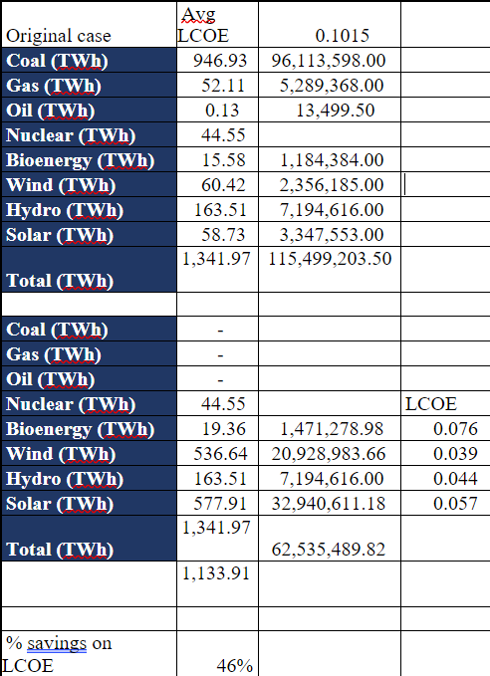
7.

Slide 40
8. Following is the list of companies who have applied for ACC PLI scheme:
1. Reliance New Energy Solar Limited
2. Hyundai Global Motors Company Limited
3. Ola Electric Mobility Private Limited
4. Lucas-TVS Limited
5. Mahindra & Mahindra Limited
6. Amara Raja Batteries Limited
7. Exide Industries Limited
8. Rajesh Exports Limited
9. Larsen & Toubro Limited
10. India Power Corporation Limited
Total bidded energy is 130 GW

Slide 41
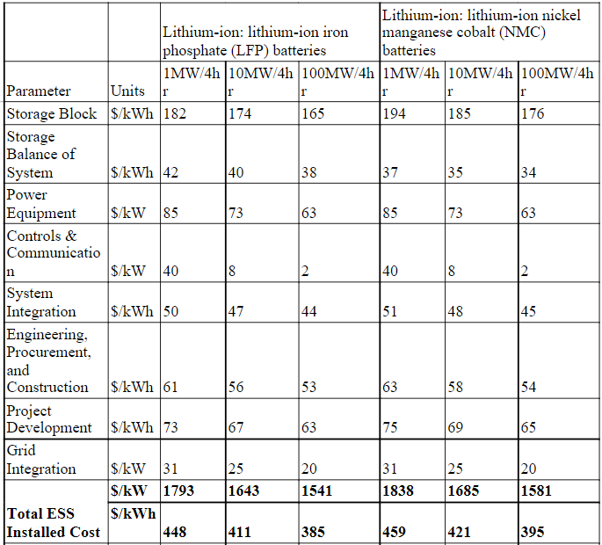
9. Grid connected battery storage costs

Slide 42
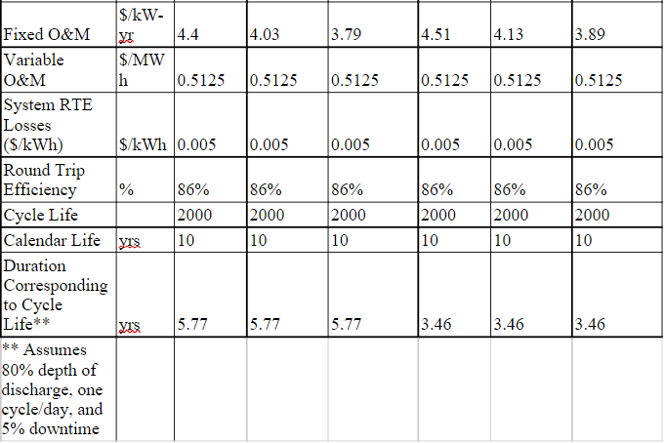
https://www.pnnl.gov/sites/default/files/media/file/Final%20-%20ESGC%20Cost%20Performance%20Report%2012-11-2020.pdf

Slide 43
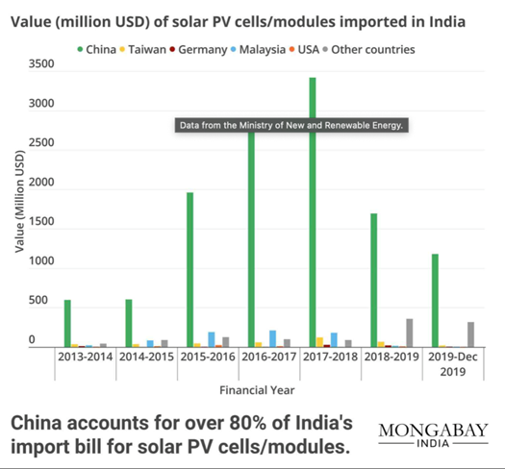
10.

Slide 44
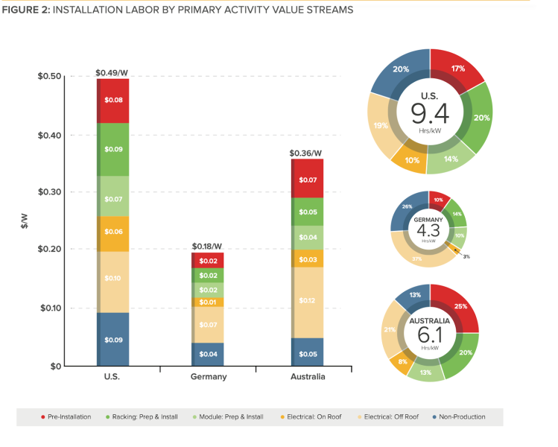
11

Slide 45
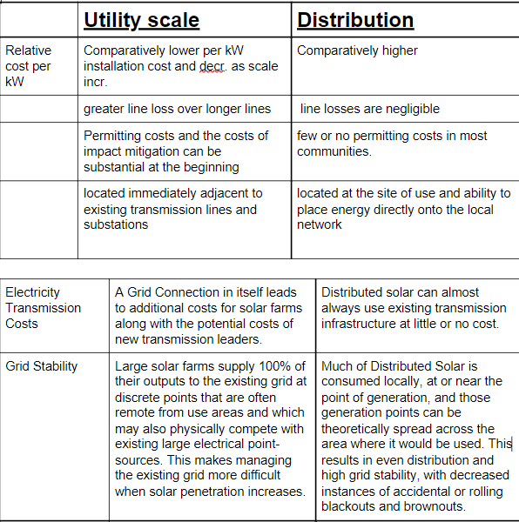
12.

Slide 46
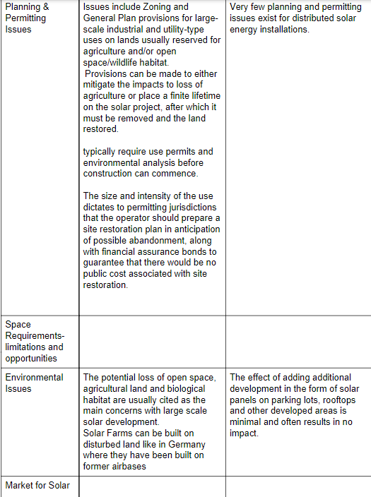
12.

Slide 47
13. Comparison Analysis of TATA Nexon ICE & TATA Nexon ICEV at 50% penetration of EVs in INDIA.
 | Tata Nexon ICE(150g/km) | Tata Nexon EV
Ex showroom price | 902000 | 1,450,000
CO2(g/km) | 375000 | -
NOx(2%) | 18040 | -
Weight(1%) | 9020 | -
Scrapping fee(0.5%) | 4510 | 4510
GST(25%) | 225050 | 72500
Retail price | 1533620 | 1,527,010

